Slide 1

Cyber Threat Intelligence For The Rest Of Us
Implementing intelligence driven threat hunting and offsec in your infosec program, without dedicated teams
Thomas Somerville - GrrCon 10 - 2021

Slide 2
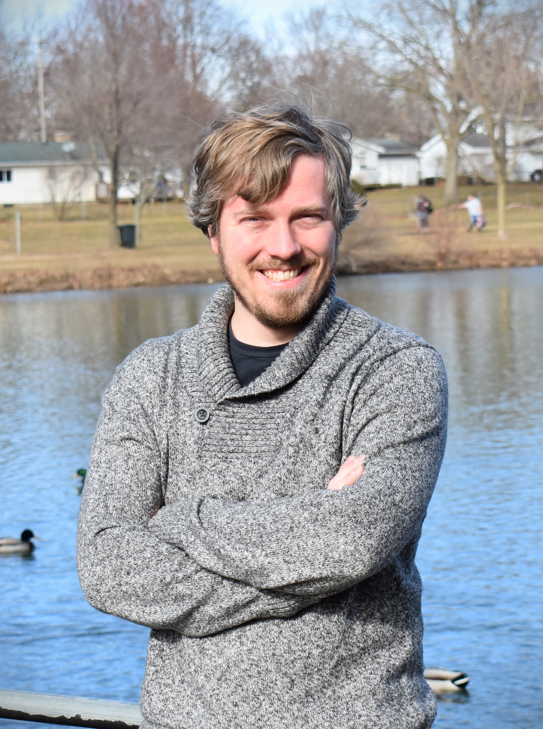
Thomas Somerville
Security Researcher At Grimm
Traditional Blue Team / IT Background
Hobbies: Woodworking & Gardening
Not Social Media To Put Here
Meet me in person to get my contact info!

Slide 3
What and Why? - Where We Were At
Sitting Pretty...
What’s Next?
Intersection of nothing, and fully dedicated team(s)
Notes:
So while I my previous employer, we were in a position where we were wrapping up the finishing details on a multi year complete overhaul of our infosec program. Im talking like, splitting up into multiple teams, complete pull and replace of our siem and log collection infrastructure, reassessing our tooling, additional staffing, and more.
And so, while we were sitting pretty, we had two big questions:
First, How well did we do?
Second, how to mature the program from here?
We started out with a big list of to-dos allocated across 3 people, it quickly consolidated to two people, and then consolidated further to one.
I got to have a lot of fun, being that one person that got to piece all this together into a program,
And the result of that program is what I am talking about today.

Slide 4
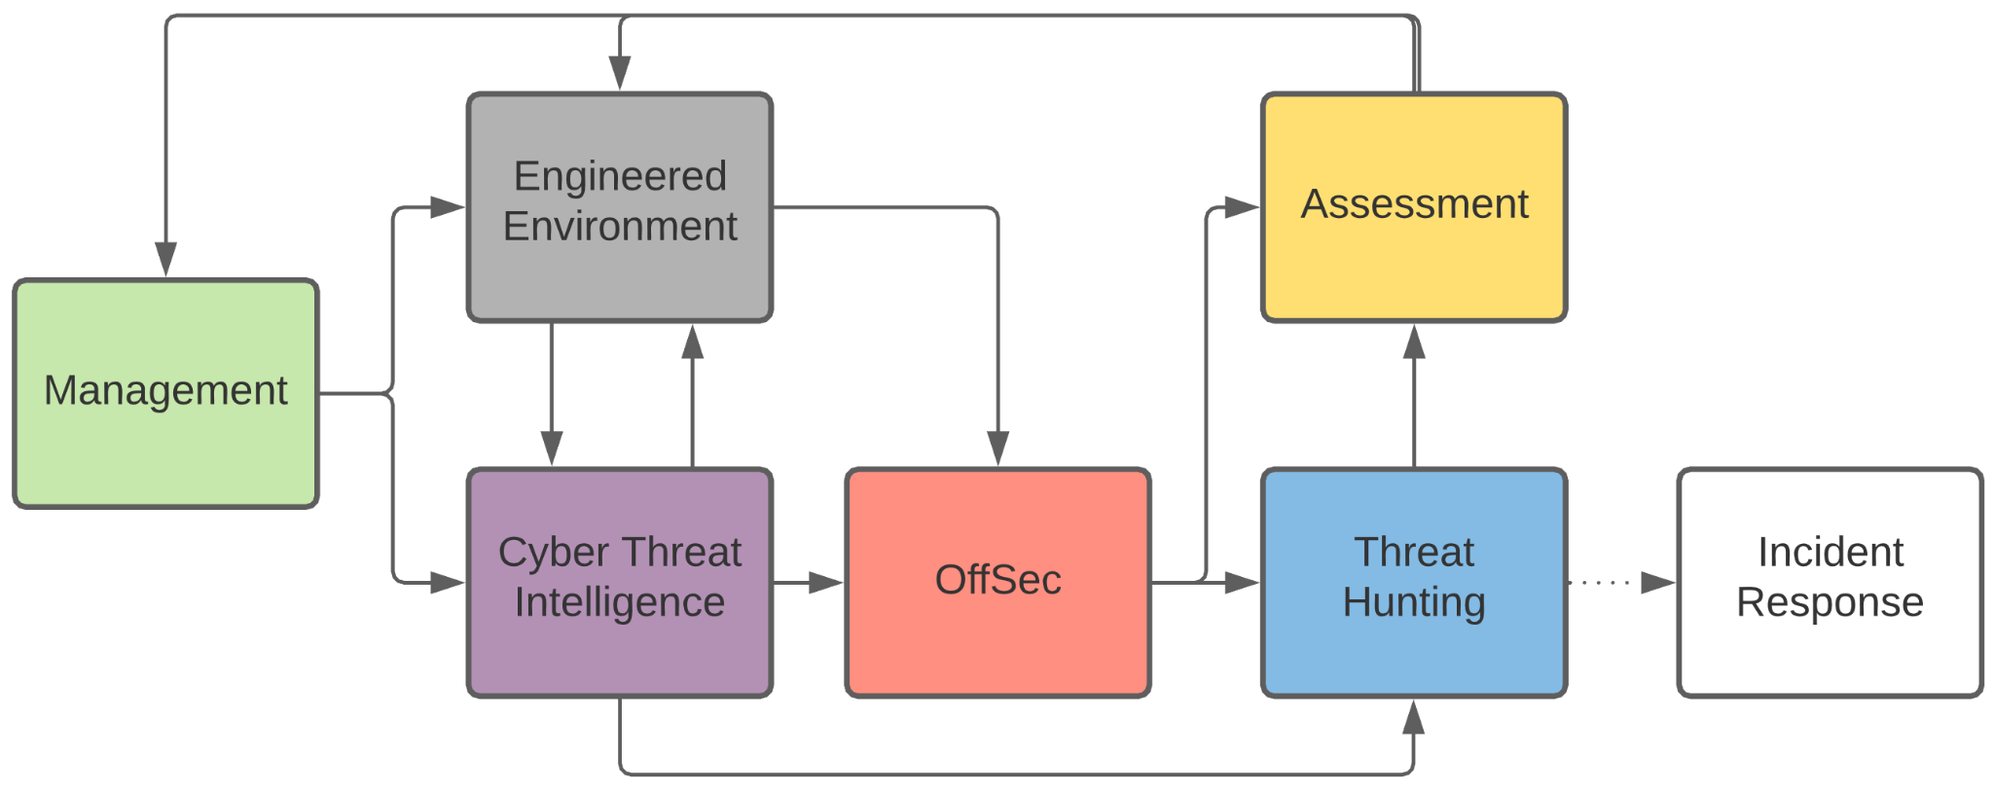
What and Why? - The Final Result
Notes:
So this is more or less what we came up with.
For us, our entry point was our engineered network. Remember we just spent years overhauling, and reorging almost everything infosec.
And all of that work influences our time spent on CTI, by narrowing our focus when researching TAs and their TTPs ( or Tactics Techniques and Procedures) that we believe our implementation should already prevent or catch.
Then we move onto CTI, where we spend our time researching threat actors that would target us, learning their TTPs, and identifying items for hunting, and emulation.
Next, onto offsec, where we actually spend some time re-creating activity in a lab environment, and then execute in production once ready, in order to put our previous engineering work to the test.
Then onto the hunting, where we spend time looking for the various TTPs we carved during our intel research, and the activity we performed during the emulation. An optional exit here for Incident response in the rare event it may be needed.
Once both offsec and hunting have been completed, we move to the ASSESSMENT part.
We just spent a lot of time playing around, and so now we assess everything we have just done, and consolidate it into actionable items.
Essentially, this is the part where we open all the JIRAs and make the fancy report to management.
Those tickets we opened will drive how we engineer our environment. In the weeks, months, or years to come.
Additionally everything gets reported directly to management, who can use this data as a way to report on the effectiveness of the program to their own bosses and peers, but also use it to plan for projects, future expenditures, justify additional staffing, etc.
Management can also have an input into the whole life cycle. For example maybe they want to measure our capability to detect, and respond to that big thing in the news that happened last week.
And then the whole thing repeats on loop. But the best part is, that this train doesn’t have a fixed speed, and how long and how often you repeat the cycle is up to you, your available time and resources.
I would usually fit this whole life cycle into a single week. One individual, for one week, would do everything we just talked about, minus the resolution of any engineering or project work identified, and we would repeat this roughly every 6 weeks.

Slide 5
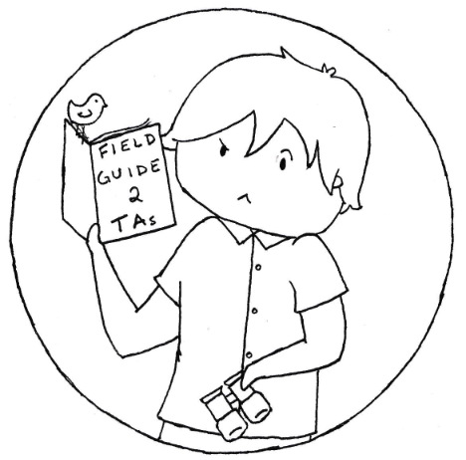
Cyber Threat Intelligence
Notes:
So, onto what it actually looks like to perform all this activity.

Slide 6
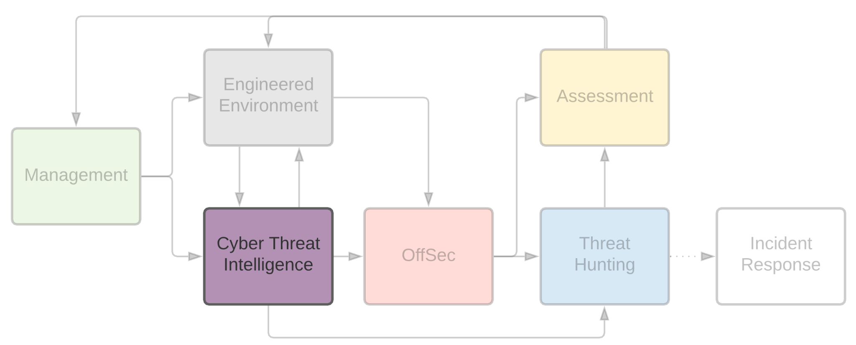
Cyber Threat Intelligence
Notes:
We start with Cyber Threat Intelligence. This is what ensures we optimize our time and do not spend our time hunting for or emulating items not relevant to us or our environment.
Our threat intel is obtained from a few different sources, we used some paid for, as well as some free. During this presentation, Ill be using all Open Threat Intel.

Slide 7
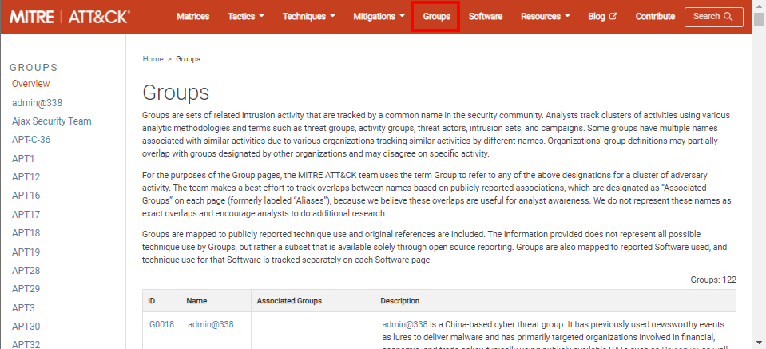
Cyber Threat Intelligence - MITRE Groups
attack.mitre.org/groups
Notes:
My favorite free source of intel is by far from MITRE, and their Groups page is definitely my favorite corner of their site.
Ill will say, that for a very long time open threat intelligence was useful enough, I barely touched the paid for intel even though I had it.
If you plan to implement something similar to this, you do not need paid intel for a good while. There is value there for paid intelligence. Mainly, frequency and relevancy.
A lot of time, open intel is dated, and things may no longer work asdescribed in the report, which may be in part why they have become open. Paid intel gets you what happened today, yesterday, or last week. Rather than what happened months ago, or maybe even a year or two ago.

Slide 8
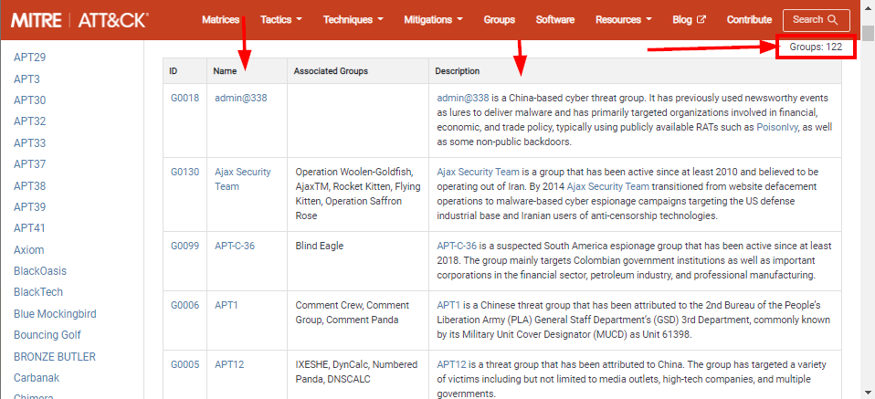
Cyber Threat Intelligence
Cyber Threat Intelligence - Finding Our TAs
Notes:
Ok, so first we compiled a short list of TAs relevant to us.,
Initially, the compilation of this list took a little time. However once compiled, I only occasionally had to update it.
Note this list does not have to be perfect to derive value, there will likely be many threat actors applicable to you, if you miss one or two, you will still be plenty effective, so dont sweat this too much.
So how do we identify groups relevant to us?
Using Mitre Groups, we can simply read the descriptions column.

Slide 9
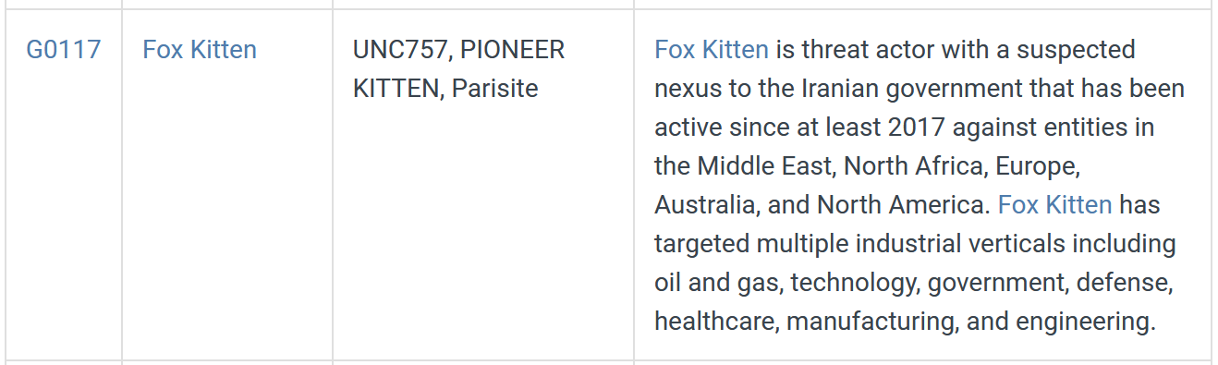
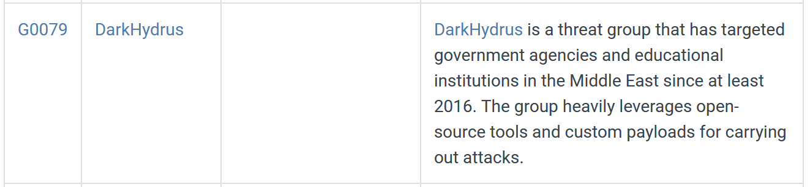
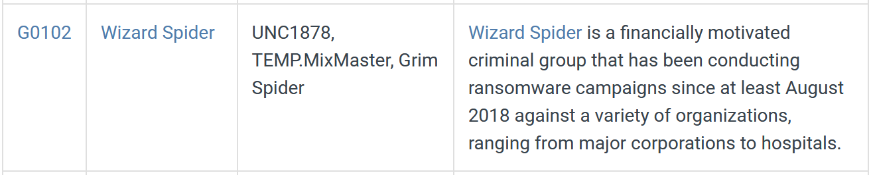
Cyber Threat Intelligence - TA Descriptions
Notes:
Let’s say you are a large manufacturing company based in the US:
You would probably be interested in knowing what Fox Kitten is doing up there on the top.
Probably less interested in DarkHydrus there in the middle
But what about a group like Wizard Spider? Ill give you a hint, most of us should probably should care about most groups that are classified as financially motivated or E-crime. So I would definitely recommend following, hunting, and emulating those generic e-crime TAs

Slide 10
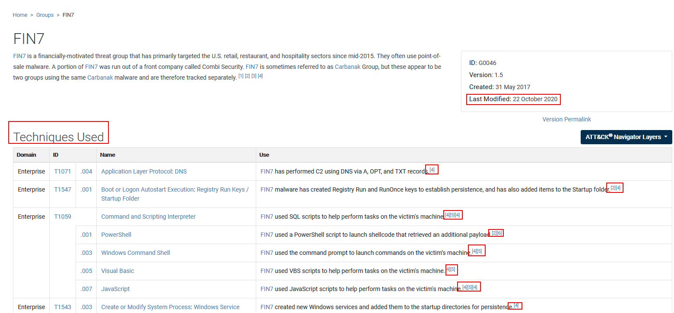
Cyber Threat Intelligence - Groups Page /Top
Notes:
now that I know who would target me, now I change my focus to how they are targeting me.
Mondays would start with a genric ‘who has been active recently, and a quick look to see if any new TAs have moved into our space’.
We generally would choose a threat actor for the week that has been active recently, and who hasnt gotten attention from us in a while.
Lets take Fin7 for a spin in this talk.
When we go to the actor page, we see the page last modified date, useful for knowing about how active this TA is. Note this is not a date when the TA was last active, but when MITRE has last updated this groups page. The intel they have updated the page with may or may not be recent.
The meat of the Groups page is the Techniques used, mapped to attack obviously. Which is useful to us for our overall tracking of TTPs that have been validated in our environment.
Note the footnote references to the right of each technique, those little numbers, link to the publicly available source document, with more details.

Slide 11
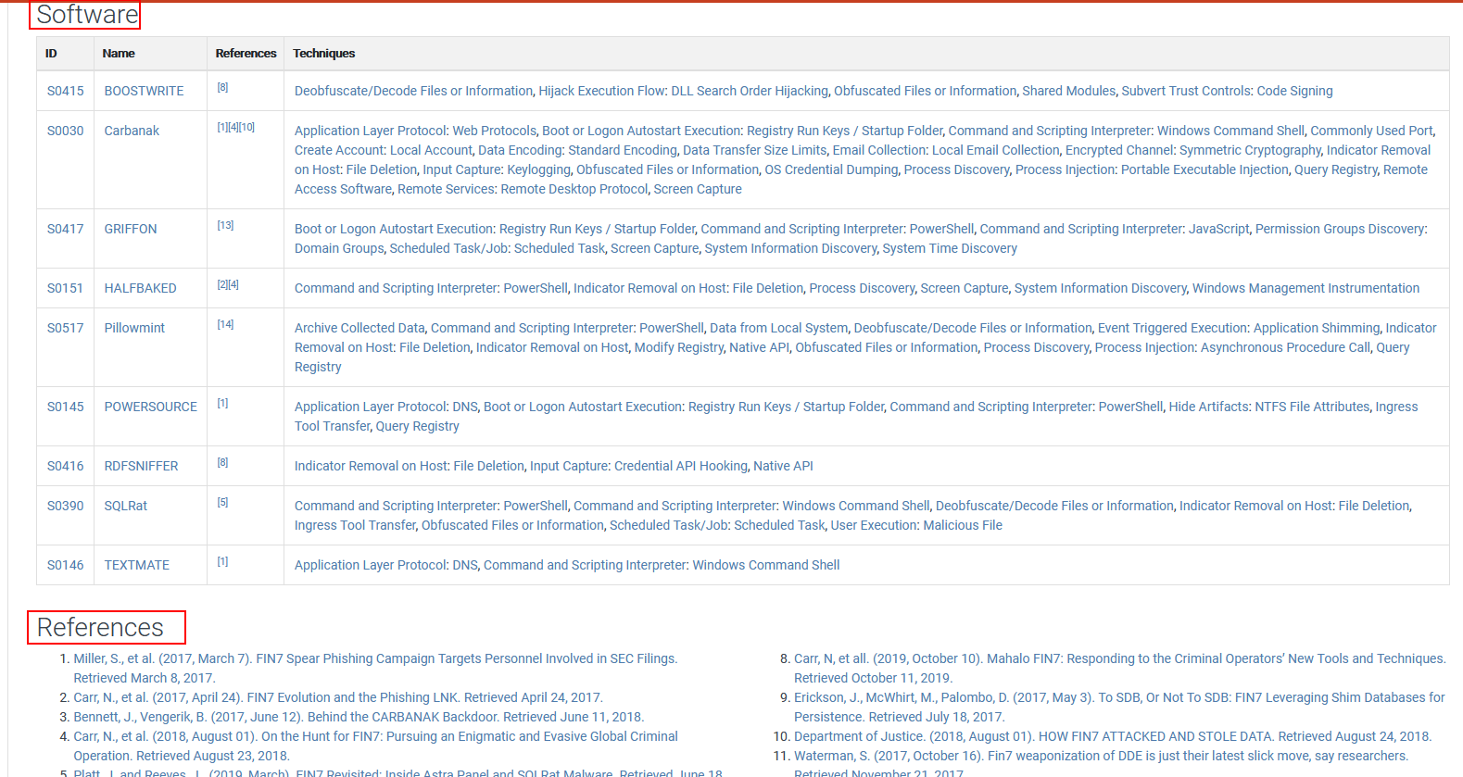
Cyber Threat Intelligence - Groups Page /Bottom
Notes:
Scrolling down a little farther, we have a list of software the TA has been known to use and links to the references.
So going through the references here, Im going to grab one of the more recent ones. Eventually, I may work through all of these, for every TA. Probably wont, things date pretty quickly and Ill probably move onto paid intel before then, but I guess you could...

Slide 12
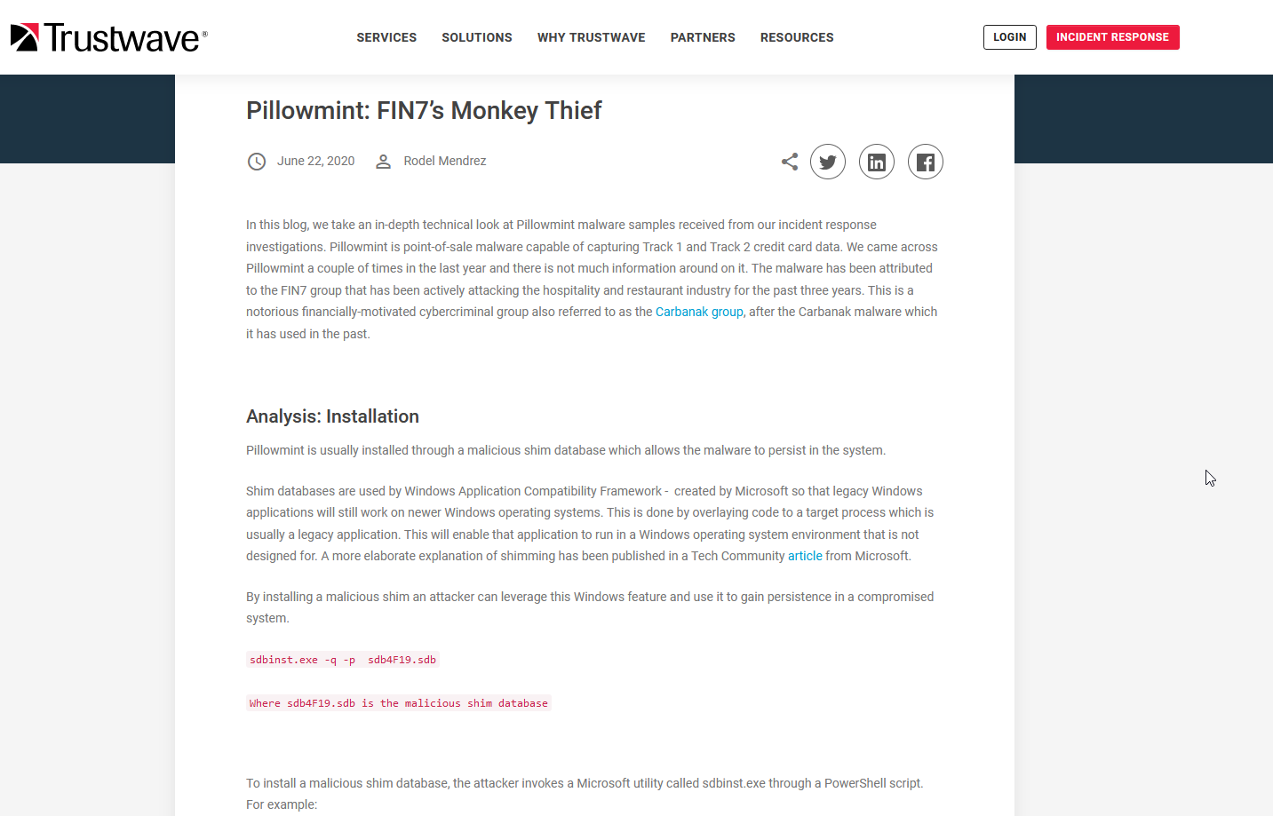
Cyber Threat Intelligence - Example Report
https://www.trustwave.com/en-us/resources/blogs/spiderlabs-blog/pillowmint-fin7s-monkey-thief/
Notes:
So lets click on one, and it takes us to a report by Spiderlabs.
We already have an actor to emulate and hunt this week, Fin7 in this case, all of their tactics and techniques and neatly laid out, and this report should get us some of their procedures for the techniques they use.
And just in the first paragraph, we already have some interesting data.

Slide 13
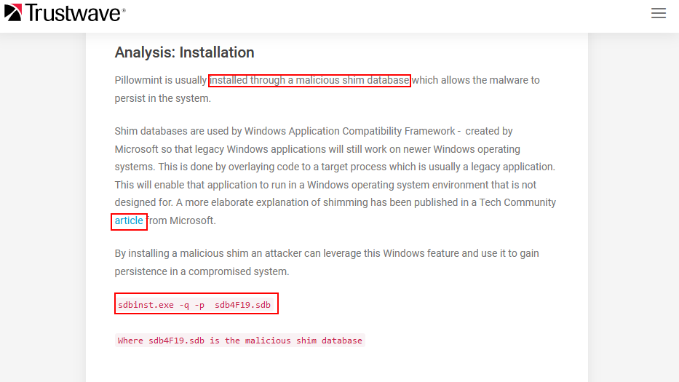
Cyber Threat Intelligence - Parsing The Report
Notes:
Their payload pillowmint is installed through application shimming
It tells us what shimming is, and reference for more detail
It tells us what they shim for (Persistence)
And exactly what the install looks like.

Slide 14
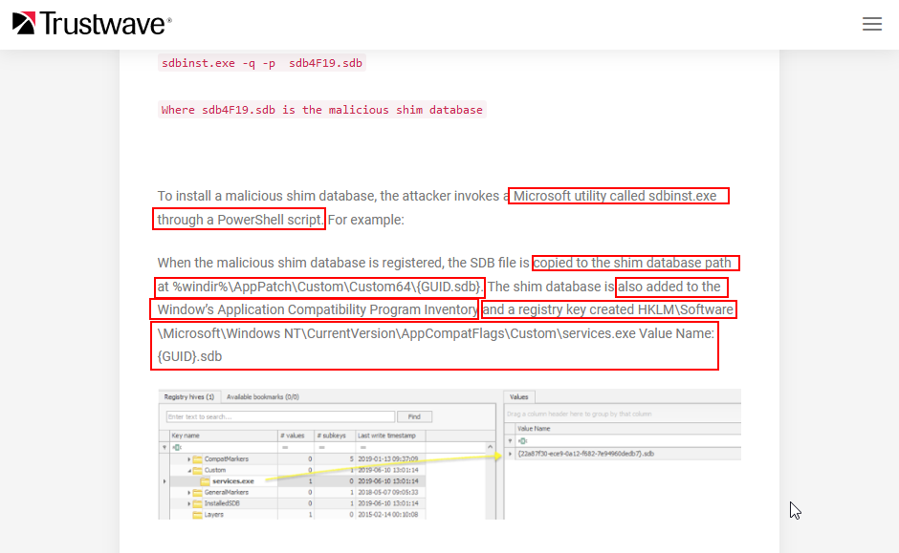
Cyber Threat Intelligence - Parsing The Report
Notes:
We can go down further, and that the utility they use is a native MS binary, and is initiated from a PS script.
It tells us where the shim db is copied to after intall, ------ we can look for that.
Tells us which registry keys are modified, more things to look for
These things are usually very densely packed with information, and I could probably just sit up here and translate this report for the whole 30 minutes, so Ill abbreviate the parsing and stop here..
With time, you will learn what makes sense to hunt on in your environment, and how to recognize and pull valuable actionable data out of these.

Slide 15
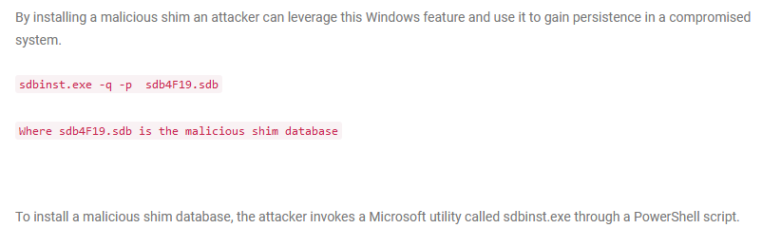
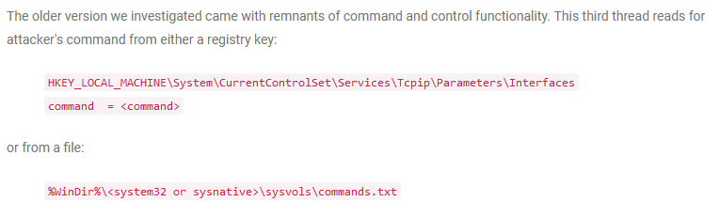
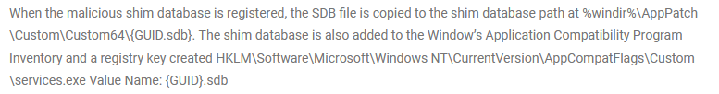
Cyber Threat Intelligence - Our Actionable Intel
Notes:
So This is just all the actional Intel that I pulled out of this report, that I could fit on this screen.
So at the end of monday, I have a identified
TA potentially interested in my environment to focus on for the week.
A number of TTPs that the actor is known for using.
A list of procedures to hunt for later on.
And at least one procedure to emulate.
What we just covered won’t usually take a full day, and so you should have ample time to run over many detailed intel reports on your TA of choice. Pick good targets for hunting and emulation, and maybe start on the next portion later in the afternoon.

Slide 16
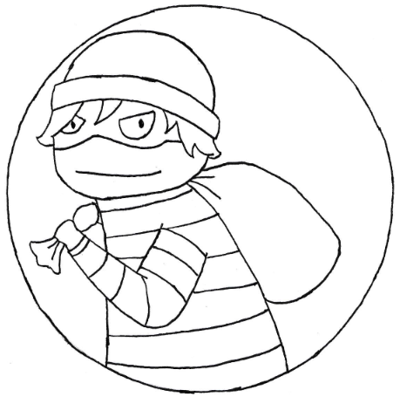
OffSec
Notes:
Ok onto emulation or maybe just general offsec.
Dont worry too much about the code that will be on the screen. Some times its a bit hard to read all that text and we will be moving fast because there is a lot of content for the allotted time. Everything is already up on my github, ill post that link on the last slide and this talk is recorded and will be posted online so you can follow along later if you want.

Slide 17
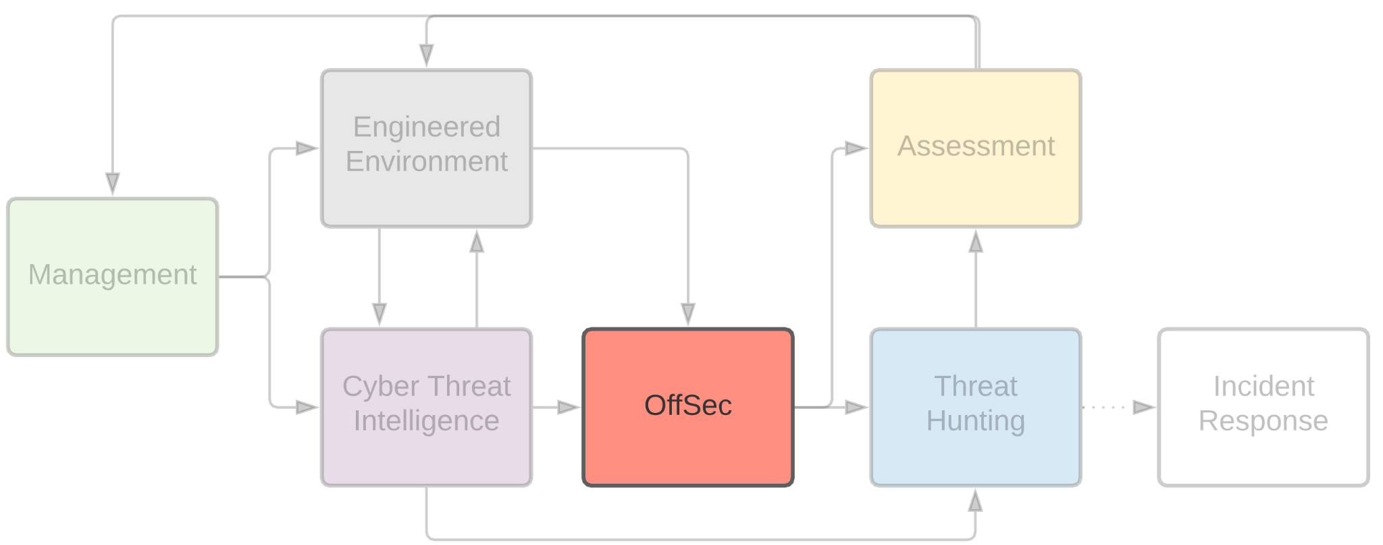
OffSec
Notes:
Now we will spend some time to emulate, as closely as we can, a portion of the attack chain in our own environment.
We generally spent 2 to 3 days on this section
From our example report, spider labs tells us that Fin7 uses a:
Powershell script to install shimdb that patches the payment processing service, the shimed code executes a malicious payload in a registry hive, and the malicious payload is pillowmint.
So thats what we will try to do here:
Obviously im not going to isntall pillowmint, so we will change up the malicious paload to our own.
I dont have the same the target application that was shimmed, so we will also provide our own there too.

Slide 18
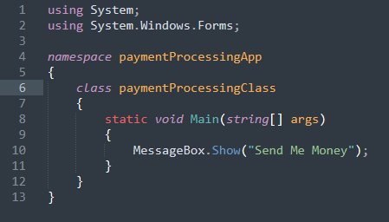
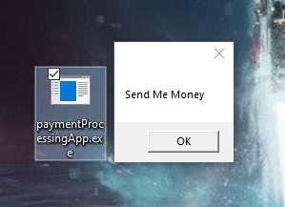
OffSec - Our Payment Processing App
Notes:
OK, so to start, I dont have the same payment processing application they shimmed, so Im going to whip up a fake one to target.
Here is the source, and what it look like when I run it.
Brilliant, i know.

Slide 19
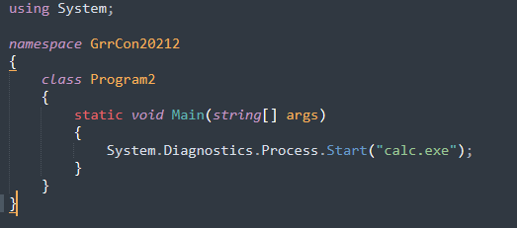
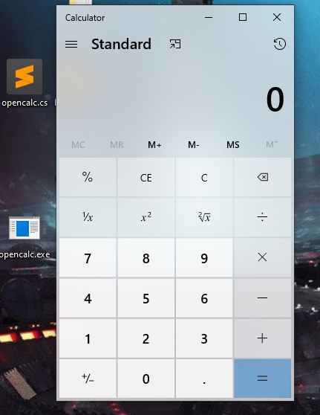
OffSec - Super Malicous Calc.exe
Notes:
Next we need a malicious payload. So in true POC tradition, Ill whip up a simple program that runs the ever menacing calc.exe when executed. Compile that and test it out.

Slide 20
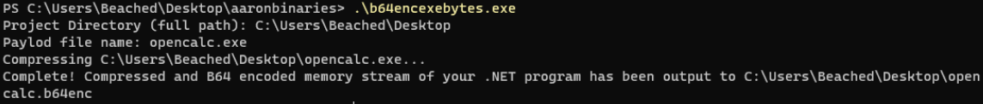
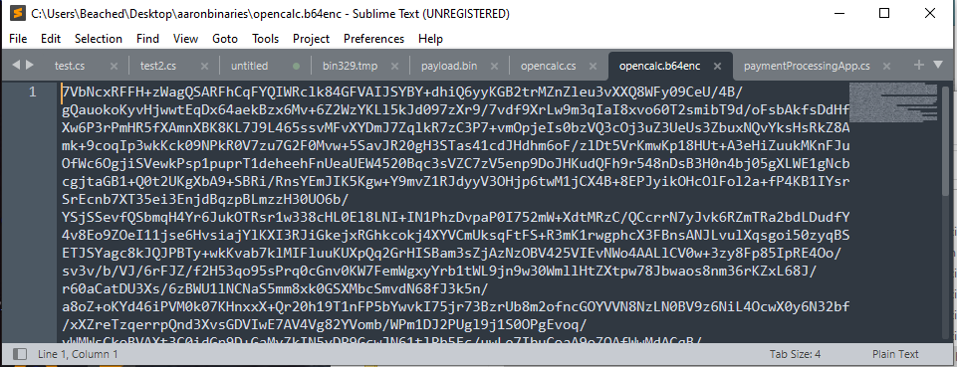
OffSec - Convert Binary To Encoded String
Notes:
Next, the report says the the final payload is stored in the reg key, so I need to serialize the binary to store it as a string. So here I convert the binary into a byte array, compress and b64 encode it.

Slide 21
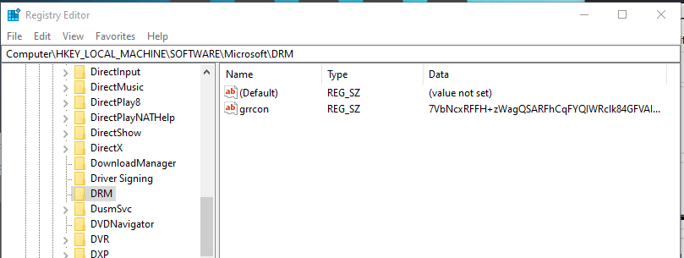
OffSec - Placing The Binary Into A RegKey
Notes:
Here we will load that string into the relevant reg key.

Slide 22
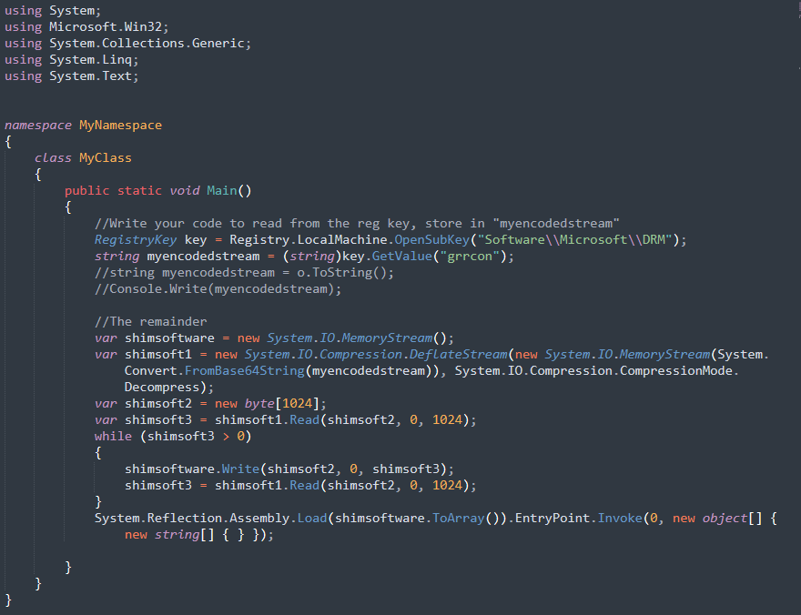
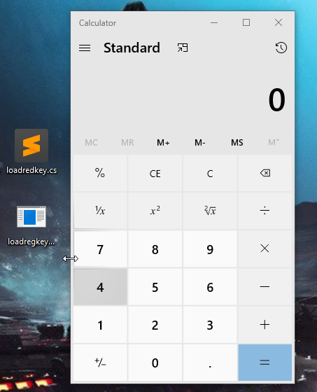
OffSec - Execute Binary Stored In RegKey
Notes:
Next, we have to have some way to pull that string out, decode, decompress, load into memory and execute. So here we create some code, Compile this up and test it out. Looks good, calc has run, which means it was able to execute what was stored in the reg key.

Slide 23
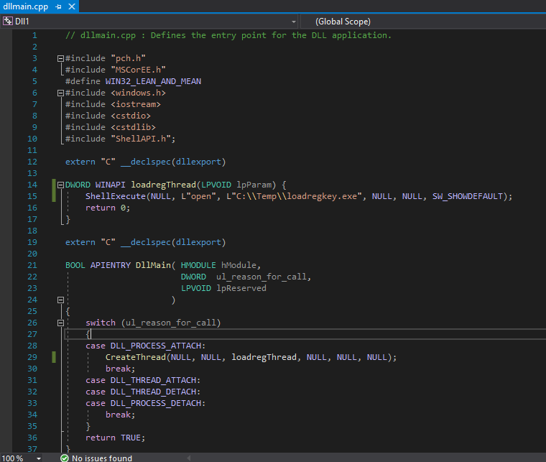
OffSec - Creating The DLL To Inject
Notes:
Now, we work on creating the dll that will be shimmed into our payment processing app.
This dll will execute that binary that decodes, decompresses, and executes the reg key value.
The dll had to be written in C++ because dlls created in C# are apparently incapable of having default entry points I guess?
Now -- The report stated that the shimmed code directly loads and executes the binary stored in the reg key from the dll
A keen eye will notice that I have one extra step, why?
My C++ is not where my python or C# is, and because at work, I would get 2, to 3 days to lab out and execute this emulation, and in the instance of this talk, i had ONE day to make it work, so these are life’s little compromises we have to live with.
I was originally super upset about having to make this compromise during a presentation, because it doesnt perfectly emulate our TA’s Procedure.
However I’m ok with it now, because I think this is an important lesson with threat emulation.
There will be times that you cannot perfectly emulate every little detail of the entire attack chain, and you will be forced to come up with a good alternative that still works and doesnt deviate too far. This is especially true, when trying to emulate C2 infrastructure.

Slide 24
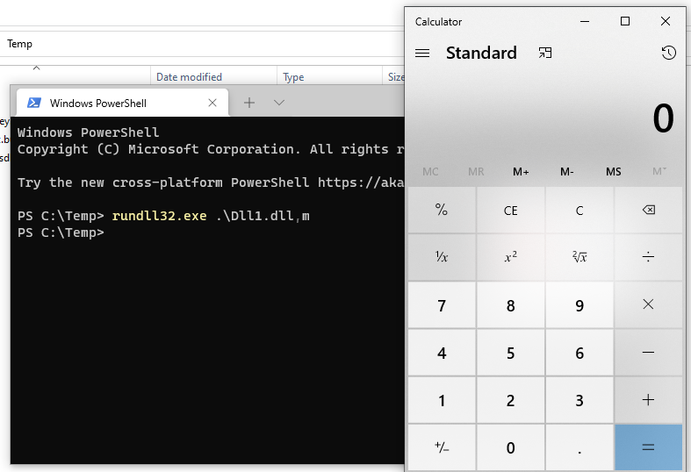
OffSec - Testing The DLL
Notes:
Once the dll is compiled, we can give this a quick test using rundll. And whala, calc opens.

Slide 25
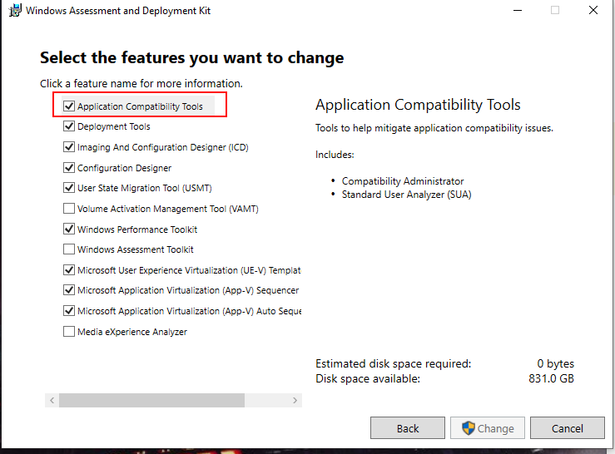
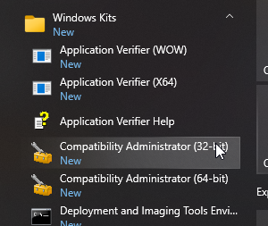
OffSec - Install MS ADK
https://docs.microsoft.com/en-us/windows-hardware/get-started/adk-install
Notes:
Now onto creating the shim db.
The shimdb patches an application by modifying or injecting into memory at run time. In our case, we will be injecting a dll at run time.
First, to create the shim, we need to install Windows Assessment development kit.

Slide 26

OffSec - Creating The Shim
Notes:
WALK THROUGH WITH VIDEO dont forget running at end
OK This is great an all, fully labbed out, however Fin7 did not execute their attack chain like this. Our report says they did all of this in a single powershell script.
So now that we have created and tested each individual part, lets throw it all together and script this out into a more portable script format.
A powershell one liner.

Slide 27
OffSec - Converting Binaries To Portable Strings
From Binary On Disk To B64 String
From B64 String to Binary On Disk
Notes:
First, we had 3 binaries.
We have our shim database
We have out dll
And we have our binary that extracts and executes out the regkey string
We can read a binaries raw bytes then base64 encode that array for later use with the powershell code at the top.
Then in our script, we can decode and stream the byte array back into a binary on disk with the code on the bottom.
The report doesnt specify how fin7 shipped binaries to the target, there are many ways, and i chose this way.

Slide 28
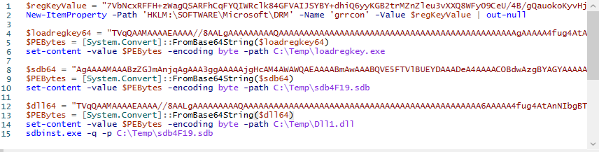
OffSec - The Final Script
Notes:
Now that we have our 3 binaries converted to a string, we can whip up a test ps script.
This is what it looks like in a human readable format.
We can convert this to a “One Liner” by separating each line with a semicolon and removing all line breaks
Upload full script to github
Include my PE to b64 scripts links
https://github.com/TomSomerville/psstuff

Slide 29
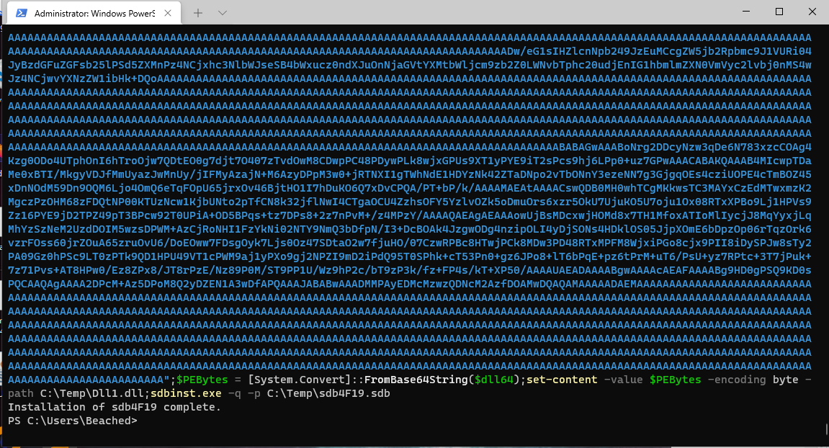
OffSec
Notes:
Lets copy that one liner onto the paste board and dump it into powershell and hit enter.
We are greeted with the STDOUT that says the shim has been installed.

Slide 30
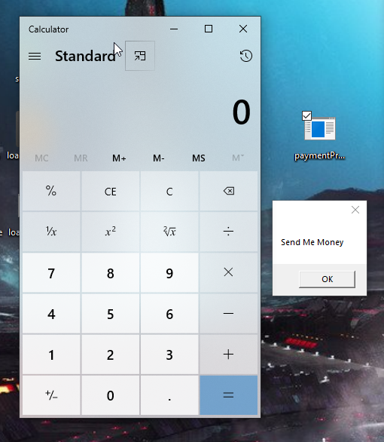
OffSec - Now Go Run In Prod
Notes:
And if we go back to our payment processing app, Success our super duper trojan opens along with our payment processing app.
Emulation portion of the week completed, and onto hunt and review.

Slide 31

Threat Hunting
Notes:
Monday left me with a lot of good things to hunt for And tuesday, Wednesday, and probably a good part or all of thursday, I actually performed the activity, or at least part of the activity Ill be hunting for.
Now, it’s time to go looking for it.

Slide 32
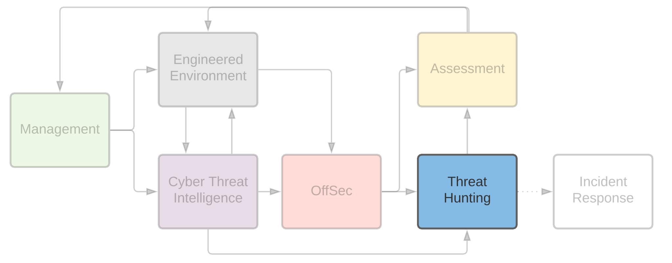
Threat Hunting
Notes:
So why wait to hunt until after emulation? Because now we have a control. And during the actor emulation, we already tested at least four things.
Our protection measures
Our detection measures
Analyst capability to properly triage and respond
ANd probably our SOC’s playbooks

Slide 33

Threat Hunting - Review Our Notes From CTI
Notes:
While we hunt, let’s think back to our intel, and what we should be looking for:
Do we expect the use of shim databases in our environment?
Do we see the relevant shim dbs in the relevant paths?
Do we see command execution for sdbinst.exe
Are the relevant reg keys set, and if so, to what? What is the normal value for these keys?
Do we, or have we ever seen any other of the relevant files created?
And then of course, other items we may have noted down for hunting, other reports or did not include in this talk’s examples.

Slide 34
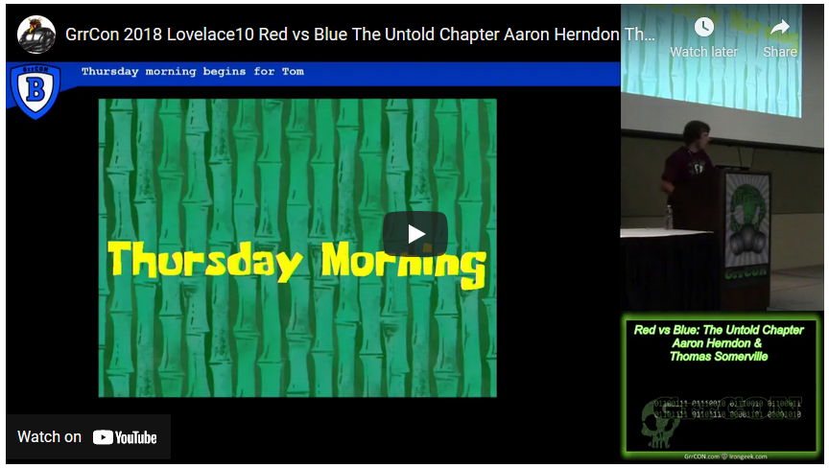
Threat Hunting - Dope Queries, Do Them
http://www.irongeek.com/i.php?page=videos/grrcon2018/grrcon-2018-lovelace10-red-vs-blue-the-untold-chapter-aaron-herndon-thomas-somerville
Notes:
Now how to query for this activity is largely going to depend on your environment, your SIEM, your log sources.
Im not really going to go into any details on how to query your siem. Aaron and I already made that talk a back in 2018. Here’s the link
But if you are thinking about implementing a program like this, you should by now, know how to query your logs.
Instead l’ll more focus on a few things to keep in mind, while you’re writing some dope queries:

Slide 35
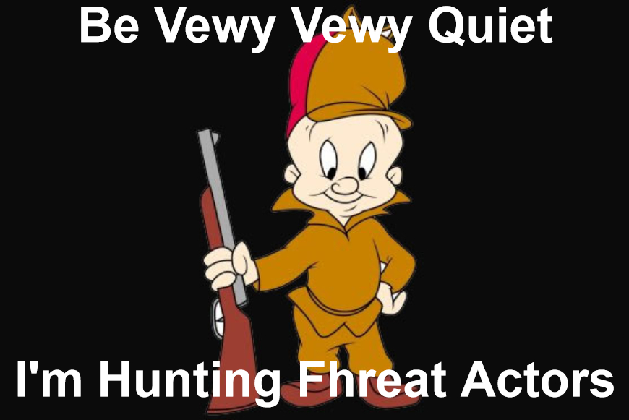
Threat Hunting - Things To Also Do
Do more than hunt for TTPs
Hunt for missing data
Hunt for areas of improvement
Non-Malicious Activity Is A finding
Is This Technology Stupid
Make your Architects cry by forcing them to relive all those times they couldn’t push through secure design, and then show them how they can be abused in prod and the devs still don’t care...
Notes:
You should at least think that you collect logs in this environment, We just performed that activity, so if you go looking for it and don’t see it, one of two things must change. Write better queries, or start looking into my log collection configs.
Are their devices in that environment that are for some reason missing from my logs?
What about dev, pre-prod environments? Lab environments?
Go re-perform the same activity in various different environments to double check.
Also remember non malicious activity are still findings:
It is very common to spend hours upon hours of hunting that result in zero malicious activity identified,
But it wasnt a waste of time. Remember that most of the time, your hunting activities are going to end up like this.
And If they don’t I feel so bad for you.
While hunting, ask yourself, should this type of activity be allowed to execute under any circumstances?
In our example, do we want to allow application shimming in the first place? Or Anywhere in our environment?
Hunts will often result in assessments for the architecture teams to review certain deployments / projects that have clearly not consulted sanity during the design phase.

Slide 36

Threat Hunting - Think About Your Future
Don’t hunt twice
Make detections, even if you have protections
Keep notes for next week!
Notes:
Lastly, and I think most critically, Dont hunt this activity twice.
In reality you probably will rehunt this, or very similar activity in the future. As you likely won’t be able to prevent everything from executing in all places always and forever with 100% certainty.
Regardless of protections in place that you encountered during emulation, do we currently detect for this activity?
You should still detect for activity that you have prevention mechanisms in place for.
And if it was worth your time to emulate or hunt for, you should figure out how you can convert that into continuous coverage going forward.
If I hunted for it, Im writing a detection rule for it, if one does not already exist.
While hunting for activity, keep in mind the structure of your logs, and the sequence of activity. What would be the most reliable way to perform detections? How would you tune new or existing rules so your analysts (or future self) dont hate you?
Remember, you or the person sitting next to you are likely the one who will have to write the detection rules for everything you just spent time on.
If you are already tearing through logs, keep all these things in mind and take some notes for later, so you dont have to do it twice.

Slide 37
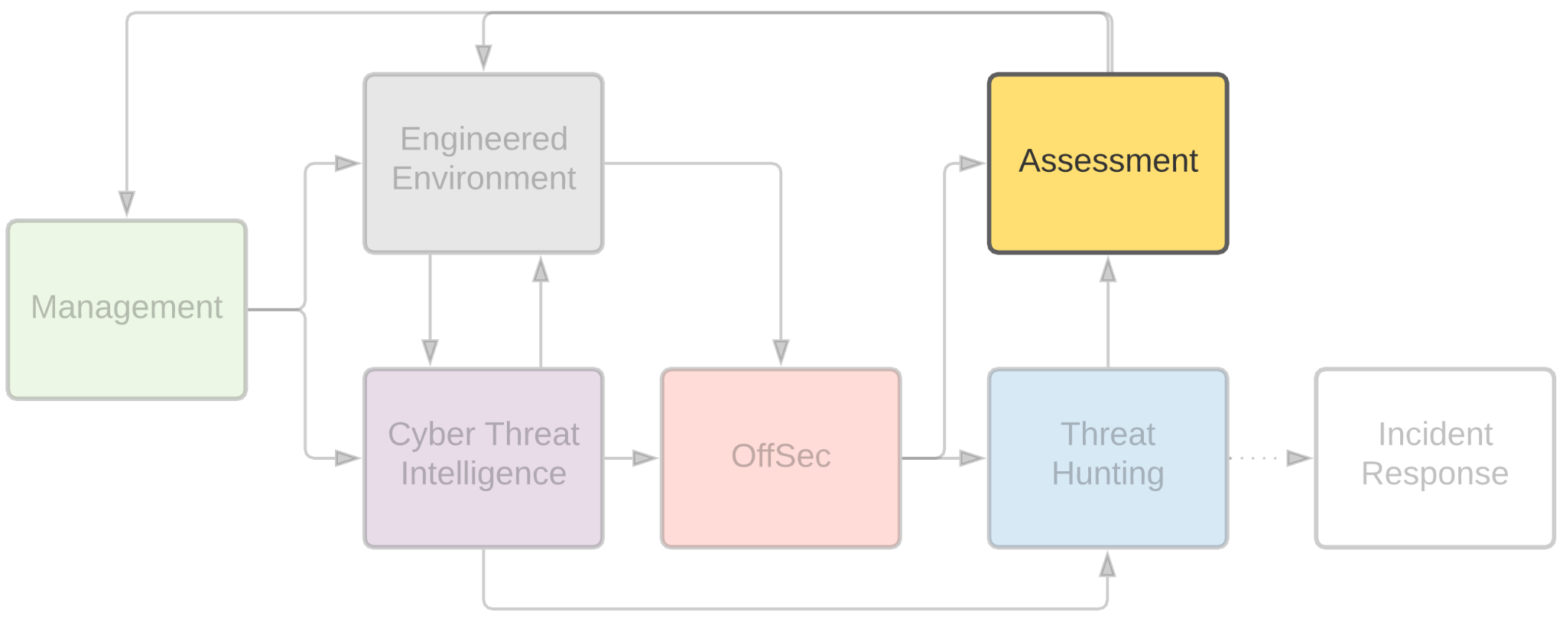
Assessment
Notes:
So what value did we provide this week? And what do we write up in those reports that management loves so much?
We have updated our list of TAs that would hypothetically be interested in us.
We learned more about what their recent activity has been, which of them are active, and which of them are dormant.
We learned what their latest motives and TTPs are. If they have remained the same or have changed.
We have increased our knowledge of where our attack surface intersects with the TAs capabilities.
We have tested at least some real world procedures in our own environment
We were able to see how our protection capability against the said procedures stands up
We were able to see how well our detection capability for said procedures is
And we were able to test our log collection capability
And We were able to test our analyst response capability
Which also means we inherently were able to test / validate our existing playbooks

Slide 38
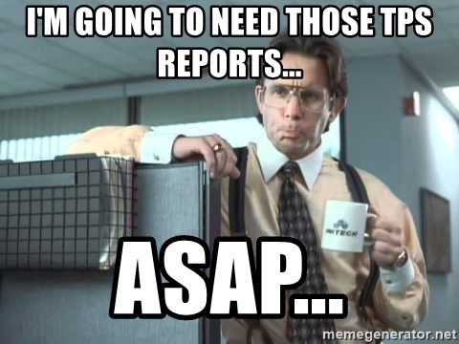
Assessment - What Do I Tell My Boss?!
Notes:
We were able to look for additional TTPs other than what we just tested (because remember we would have hunted for more than just what we emulated)
Almost certainly gained some new insight into our own environment we didnt already know
Probably uncovered shadow IT or poor engineering and opened a few JIRAs for GRC or Architecture to go over
We probably opened a number of JIRAs for our own team or future self to go over
Probably identified gaps in visibility or protection that could be closed either with project time or future purchases
We were able to provide to management validation of our various tools and procedures implementations
As well as given them data to plan for future project time, expenditures, staffing, etc.
And, we got a chance to mix up the daily routine for a week, sharpen our own knowledge and skills.
That to me sounds like a lot of value for 5 business days

Slide 39
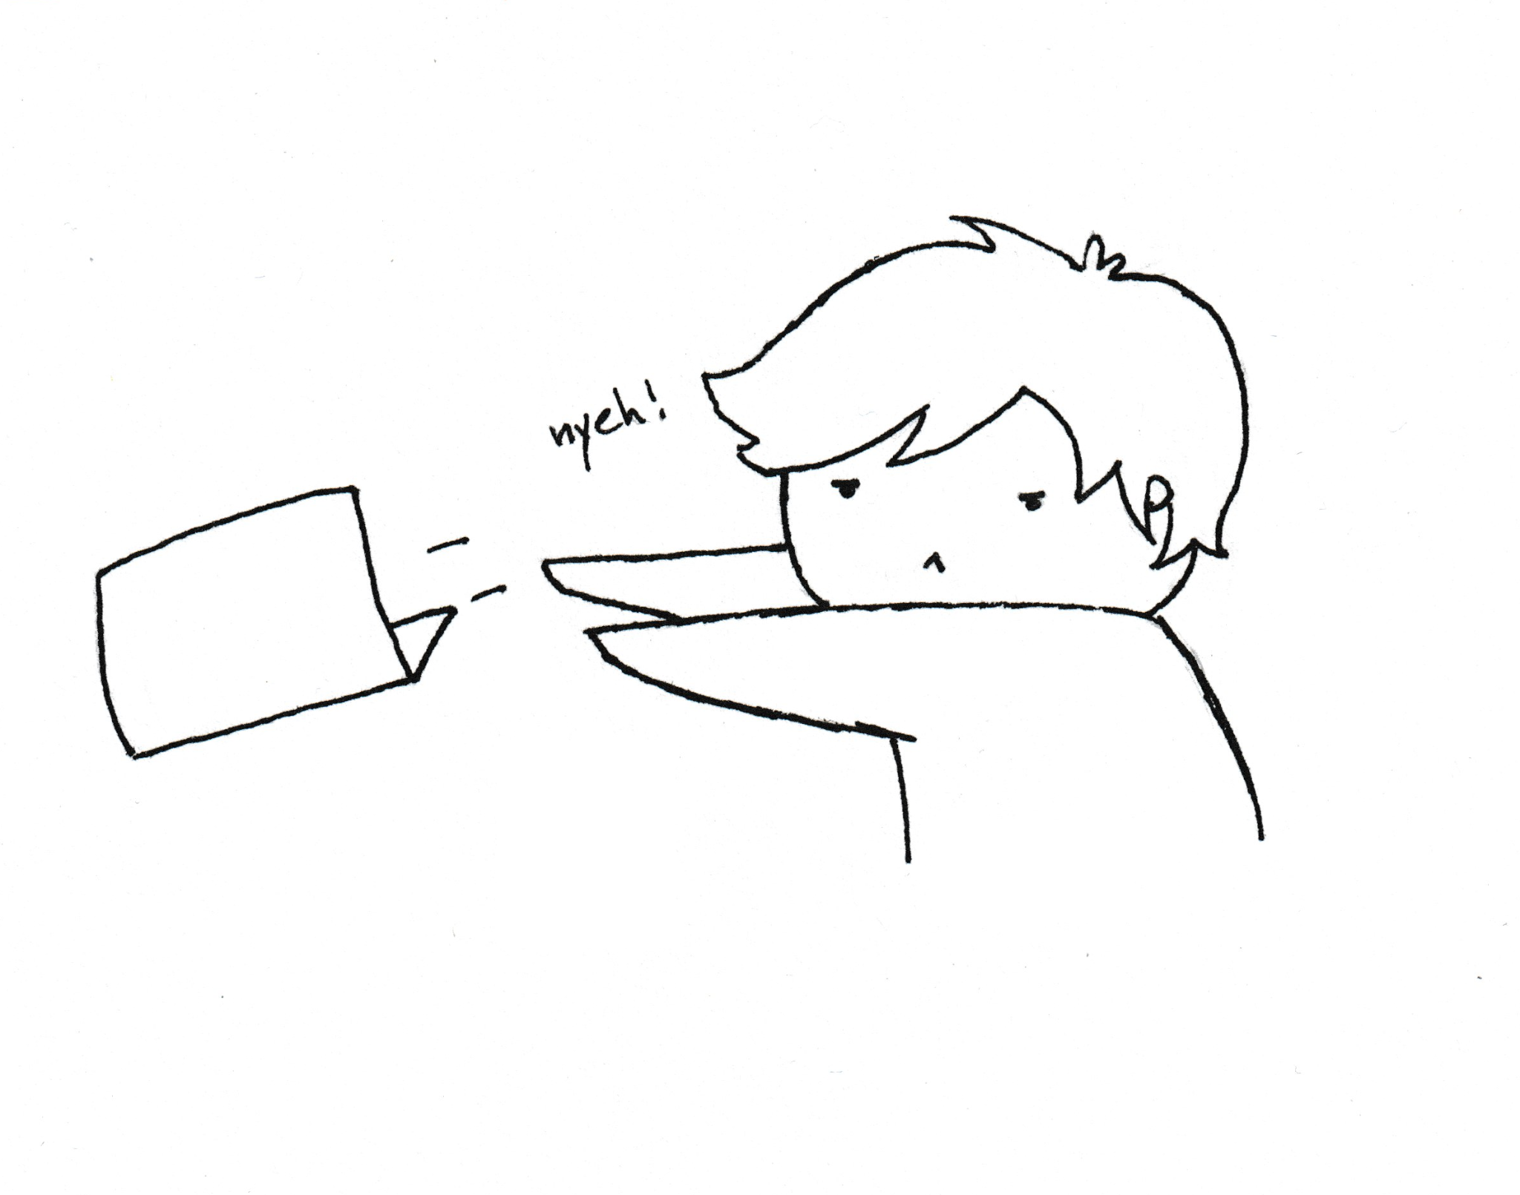
FIN
https://github.com/TomSomerville/GrrCon2021

Slide 40
FIN
https://github.com/TomSomerville/GrrCon2021

Slide 41
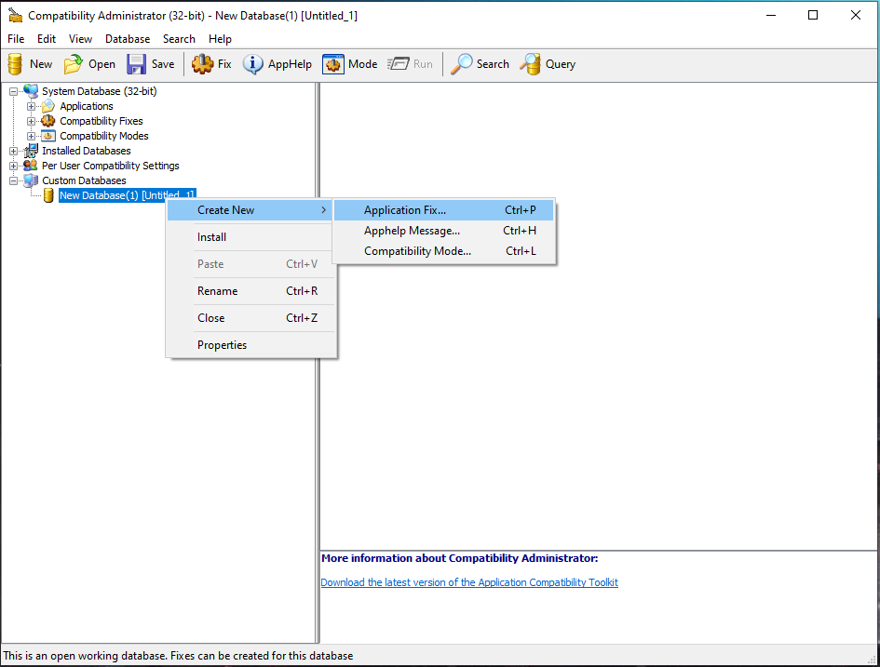
OffSec
Notes:
Once installed, open up compatibility administrator, create a new application fix.

Slide 42
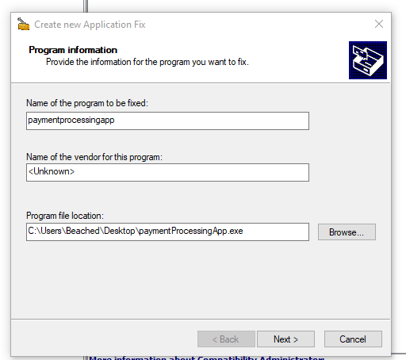
OffSec
Notes:
Give it a name, and select the application we plan to shim. In our case, our super sweet payment processing app.

Slide 43
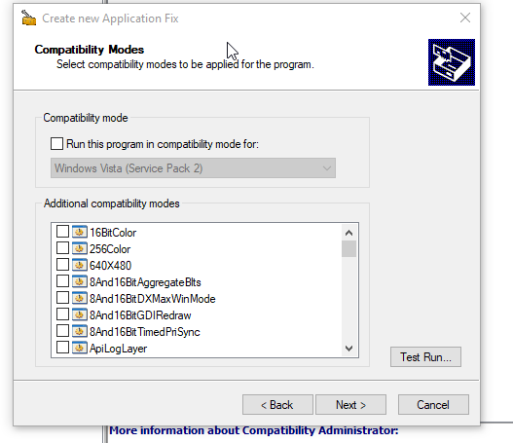
OffSec
Notes:
Skip this, we dont need this

Slide 44
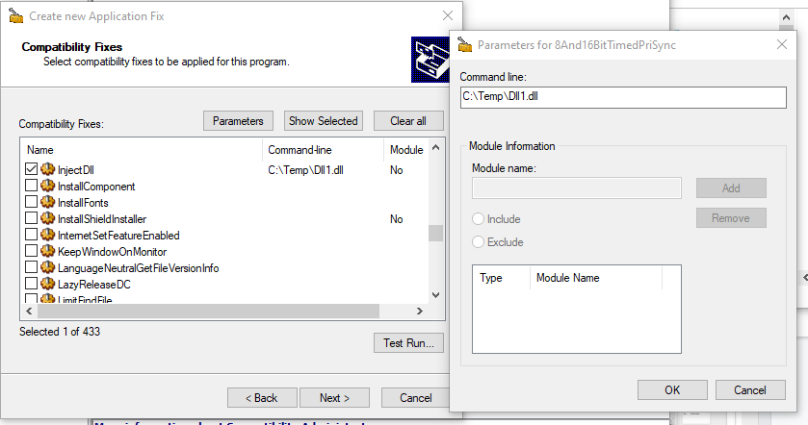
OffSec
Notes:
In the compatibility fixes section, we will select inject dll.
Hit parameters at the top, and type in the Fully qualified path to where the shim should look for the dll. In our case, we will put our dll in C:\Temp

Slide 45
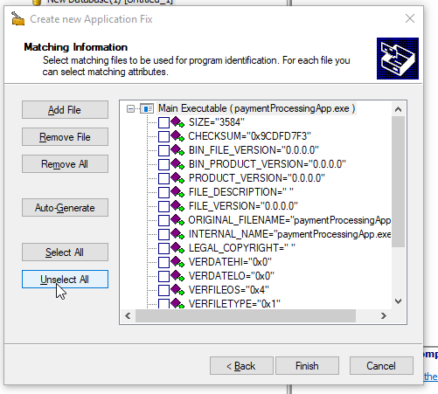
OffSec
Notes:
Unselect all these and hit finish

Slide 46
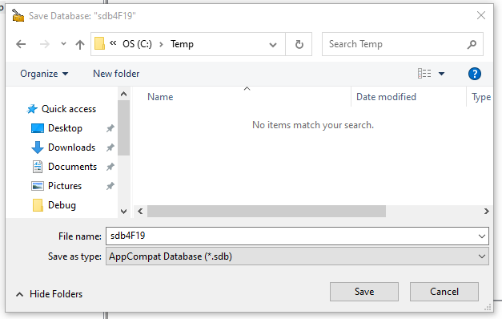
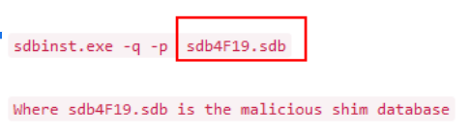
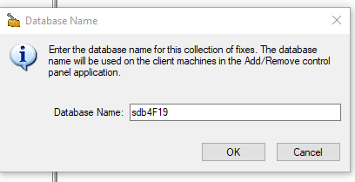
OffSec
Notes:
Hit save, we will name the database the same as fin7 did

Slide 47
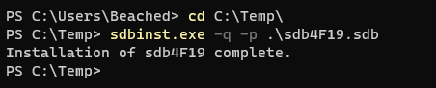

OffSec
Notes:
Now, lets install it, the same way fin7 did, and we can see install has completed successfully.

